Slide 1

AI-Powered Hand Hygiene
Using UV Imaging & YOLOv8 Object Detection to Classify Cleanliness
Discipline-Specific Artificial Intelligence Project
Team Members
Muneeb Choudhry
Jawad Goraya
Gaurav

Slide 2


Executive Agenda
01. Strategy & Context
03. Technology & Models
•
Introduction & Problem Statement
•
System Architecture Pipeline
•
Aim, Objectives & Scope
•
YOLOv8 Model Configuration
•
Stakeholders & Methodology
•
Evaluation Metrics & Results
02. Execution & Data
04. Governance & Delivery
•
Timeline & Sprint Planning
•
Interface Demo Walkthrough
•
Dataset Sourcing & Annotation
•
Risk, Cost & Responsible AI
•
Preprocessing & Augmentation
•
FAIR Report & Future Goals

Slide 3

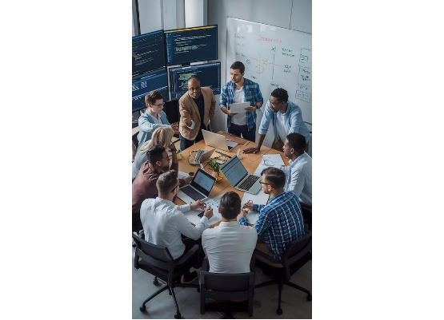
Our Team & Roles
1. Research & Data Lead
Literature review on infection prevention, UV video recording, and volunteer coordination.
2. Annotation & AI Developer
Dataset annotation strategy, Roboflow configuration, auto-labelling, and YOLOv8 training.
3. Application & Testing Lead
Streamlit development, model integration, functional validation, and UAT testing.

Slide 4
01. Introduction
Understanding the critical gap in current infection-prevention methodologies and formulating a structured, AI-driven solution.

Slide 5


The Core Challenge
The Challenge
The Solution
Hand hygiene prevents infection spread, yet assessment relies heavily on manual observation.
An automated, objective methodology capable of classifying hand cleanliness under UV light with high precision.
These manual checks are inherently subjective, inconsistent, and time-consuming, which weakens infection-prevention outcomes across both healthcare and educational settings.
By providing immediate visual feedback, the system can correct human error and reinforce proper hygiene protocols instantaneously.

Slide 6
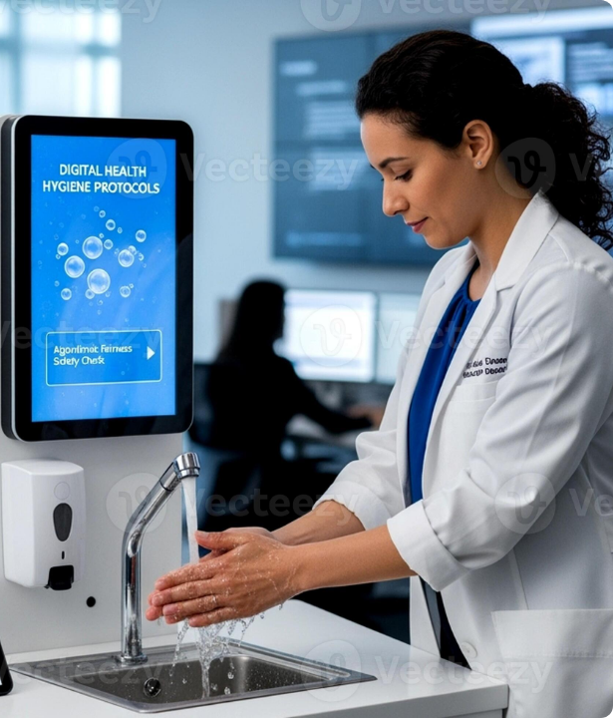
Why It Matters
Healthcare-Associated Infections (HAIs)
HAIs remain a critical risk to patients and clinical staff globally, with poor hand hygiene acting as the primary contributor to disease transmission.
Beyond Healthcare
Similar hygiene assessment gaps persist in schools, laboratories, food-preparation environments, and public facilities.
An AI-powered UV scanner offers a scalable solution to support widespread training, awareness, and infection-prevention initiatives.

Slide 7
Problem Statement
Existing hand hygiene assessment procedures are subjective and depend heavily on human observation, failing to provide consistent, objective feedback regarding contamination levels.
"
"
— Project Initiation Document

Slide 8
02. Direction & Scope
Defining clear objectives, maintaining strict project boundaries, and identifying key stakeholders involved in the ecosystem.

Slide 9






Project Aims & Objectives
Primary Aim
Data Objective
Model Objective
Develop an AI-powered system that detects and classifies hand cleanliness from UV images, delivering real-time visual feedback.
Collect, prepare, and rigorously annotate a custom UV hand hygiene image dataset using precise object detection labels.
Train a YOLOv8 model to classify hand regions (Clean, Partial, Dirty) and deploy it within an interactive Streamlit UI.

Slide 10
Expected Outcomes
Functional Prototype: A fully operational AI-based hand hygiene assessment web application.
Automated Detection: Reliable algorithmic detection of hand cleanliness levels from static images.
Visual Feedback: Real-time overlay of bounding boxes and confidence scores on uploaded media.
Practical Demonstration: Tangible proof of object detection techniques applied to a critical healthcare problem.
Educational Value: Enhanced understanding of AI applications in infection prevention and hygiene education.

Slide 11


Project Scope Boundaries
In Scope
Out of Scope
•
Collection of custom UV hand image datasets.
•
Real-time video processing and live camera feeds.
•
Annotation of defined hand hygiene categories.
•
Integration with hospital information systems.
•
YOLOv8 object detection model development.
•
User account management and authentication.
•
Classification into Clean, Partial, and Dirty.
•
Database storage of assessment results.
•
Development of a Streamlit-based user interface.
•
Mobile application deployment.
•
Clinical diagnosis or medical decision-making.
•
Real-time image analysis and visual feedback.
•
Standard performance metric evaluation.

Slide 12


Constraints & Limitations
Project Constraints
System Limitations
Factors that governed the development process and resource allocation.
Acknowledged bounds of the developed prototype's capabilities.
•
Strict timeframe (January – April 2026).
•
Dataset size is small relative to industrial standards.
•
Availability of volunteers for data collection.
•
Data collected in highly controlled environments only.
•
Access to specialised UV imaging equipment.
•
Computational demands for GPU model training.
•
Analyses static images rather than live video streams.
•
Results vary under different UV ambient lighting.

Slide 13






Key Stakeholders
Healthcare
Education
Laboratories
Hospitals, clinics, and medical professionals requiring advanced tools for staff hygiene training and stringent infection prevention activities.
Universities and schools utilizing the platform to conduct hygiene education demonstrations and reinforce proper sanitation techniques.
Lab personnel and researchers utilizing the system as a supplementary check to ensure strict contamination prevention procedures are followed.

Slide 14
03. Approach & Methodology
Combining academic research protocols with agile software engineering practices for robust delivery.

Slide 15
Applied Research Process
Investigation: Review hand hygiene challenges and existing computer-vision techniques.
Acquisition: Collect raw UV hand image data using specialized lighting setups.
Preparation: Rigorously annotate and augment the dataset for optimal machine learning ingestion.
Development: Train and fine-tune the object detection model using the YOLOv8 architecture.
Validation: Evaluate performance using strict precision, recall, and mAP metrics.
Deployment: Build a Streamlit interface and conduct end-to-end system demonstrations.

Slide 16
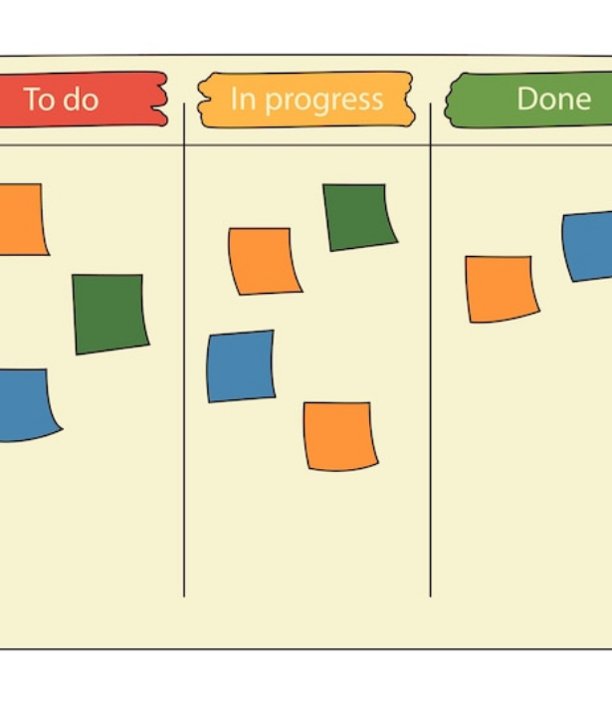
Agile Scrum Framework
Iterative Excellence
Agile was selected because it supports iterative development, continuous feedback, and incremental delivery of components.
The Scrum methodology provided short, focused development cycles allowing the team to pivot and adapt to technical challenges efficiently.
•
Incremental development cycles.
•
Continuous stakeholder feedback.
•
Regular sprint reviews and retrospectives.
•
Effective risk management and transparency.

Slide 17
04. Timeline & Sprints
A structured 12-week roadmap broken down into six distinct phases and manageable agile sprints.

Slide 18
Development Phases (1 - 3)
Phase 2: Collection
UV lamp setup, volunteer coordination, recording of videos, and frame extraction.
Phase 1: Planning
Phase 3: Annotation
Problem identification, literature review, requirements gathering, and initial project proposals.
Manual labelling, Roboflow auto-label training, verification, and data augmentation.

Slide 19
Development Phases (4 - 6)
Phase 5: Application
Streamlit interface development, user interaction design, and model pipeline integration.
Phase 4: AI Model
Phase 6: Testing
YOLOv8 configuration, model training, hyperparameter tuning, and validation.
System testing, validation testing, preparation of final reports, and live demonstrations.

Slide 20






Sprints 1 to 3 Breakdown
Sprint 1 (Wk 1-2)
Sprint 2 (Wk 3-4)
Sprint 3 (Wk 5-6)
Initiation & Research
Dataset Creation
Data Annotation
Defined project scope, identified stakeholders, and completed the literature review.
Recorded UV hand videos, extracted hundreds of image frames, and organized raw data.
Annotated initial images manually, trained auto-label model, and finalized the dataset.

Slide 21



Sprints 4 to 6 Breakdown
Sprint 4 (Wk 7-8)
Sprint 5 (Wk 9-10)
Sprint 6 (Wk 11-12)
Model Development
App Development
Testing & Deploy
Configured YOLOv8, trained object detection model, and optimized parameters.
Built the Streamlit interface, integrated the trained model, and implemented workflows.
Performed rigorous validation testing, prepared documentation, and finalized demo.

Slide 22
05. Data Pipeline
Acquiring, annotating, and processing the foundational dataset required to train an accurate computer vision model.

Slide 23

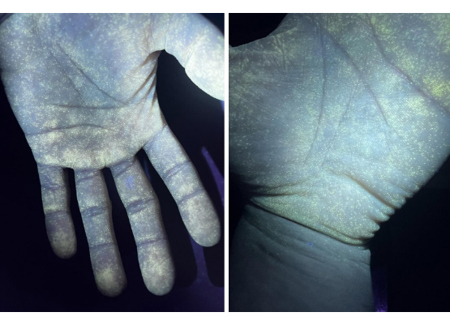
Dataset Sourcing & Collection
Due to the lack of public datasets matching our exact parameters, a custom dataset was meticulously developed.
•
Hardware Used: Mobile phone cameras combined with specialized UV lamps.
•
Process: Recorded volunteers' hands under UV illumination capturing varying contamination states.
•
Extraction: Videos processed to extract 700–800 highly detailed original image frames.
•
Diversity: Variations in hand size, skin tone, positioning, and UV reflection patterns were captured to prevent model overfitting.

Slide 24


Dataset Annotation Strategy
Manual Baseline
Automated Scaling
Initially, 90 images were annotated by hand using Roboflow. Bounding boxes were meticulously drawn and classified into three primary categories based on fluorescent residue coverage:
The manual baseline was used to train a preliminary Roboflow auto-label model.
This model automatically annotated the remaining hundreds of frames. Every single generated annotation was subsequently subjected to manual review and correction by the team to guarantee absolute dataset integrity and consistency.
Clean: Minimal fluorescent residue.
Partial: Moderate residue coverage.
Dirty: Significant residue coverage.

Slide 25






Preprocessing & Augmentation
Preprocessing
Augmentation
Final Output
•
Auto-orientation applied.
•
Horizontal flip (50% prob).
1,808 Images
•
EXIF metadata removed for privacy and normalization.
•
Vertical flip (50% prob).
Split intelligently into robust Training, Validation, and Testing subsets.
•
Random 90-degree rotations.
•
Resized globally to 512 × 512 pixels for consistency.
•
Random image cropping (0–9%).

Slide 26
06. Technical Architecture
The underlying infrastructure, models, and workflows driving the AI-powered predictions.

Slide 27
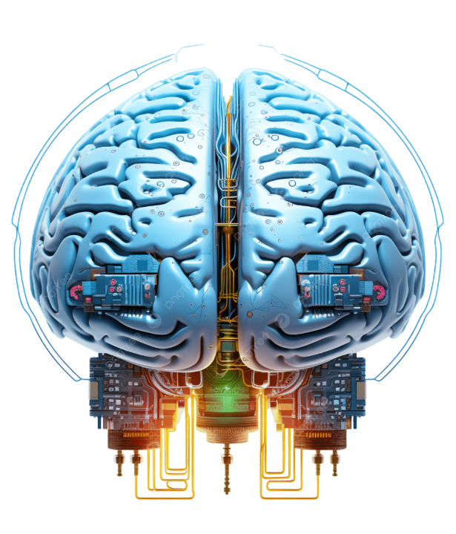
System Architecture & Pipeline
The system utilizes an elegant, low-latency 5-layer architecture flowing from user input down to result presentation.
8-Step AI Processing Pipeline
1.
Image Upload via Interface
2.
Image Validation & Normalization
3.
YOLOv8 Tensor Inference
4.
Hand Region Detection
5.
Cleanliness Classification
6.
Confidence Score Calculation
7.
Result Rendering (Bounding Boxes)
8.
User Feedback Display

Slide 28
Model Training Configuration
Why YOLOv8m?
Parameter | Configuration Value
Architecture | YOLOv8m
Epochs | 50 (with Early Stopping)
Image Size | 640
Batch Size | 16
Optimizer | AdamW
Learning Rate | 0.001
Hardware Compute | CUDA GPU Acceleration
YOLOv8m (Medium) was selected for its exceptional balance of high detection accuracy and rapid inference speed.
Unlike standard image classifiers, YOLOv8 simultaneously performs both object localisation and classification in a single pass, making it ideal for pinpointing specific hand regions on complex backgrounds.

Slide 29
07. Evaluation & Testing
Rigorous validation to ensure the model performs accurately and reliably in real-world scenarios.

Slide 30



Comprehensive Testing Strategy
Functional Testing
Integration Testing
User Acceptance (UAT)
Verified core application mechanics: successful image uploads, strict file format validation, accurate bounding box generation, and display logic.
Ensured completely seamless communication between the Streamlit front-end UI and the YOLOv8 Python backend inference pipeline.
Test images were independently uploaded and reviewed by the team to confirm predicted cleanliness levels aligned with visual realities.

Slide 31
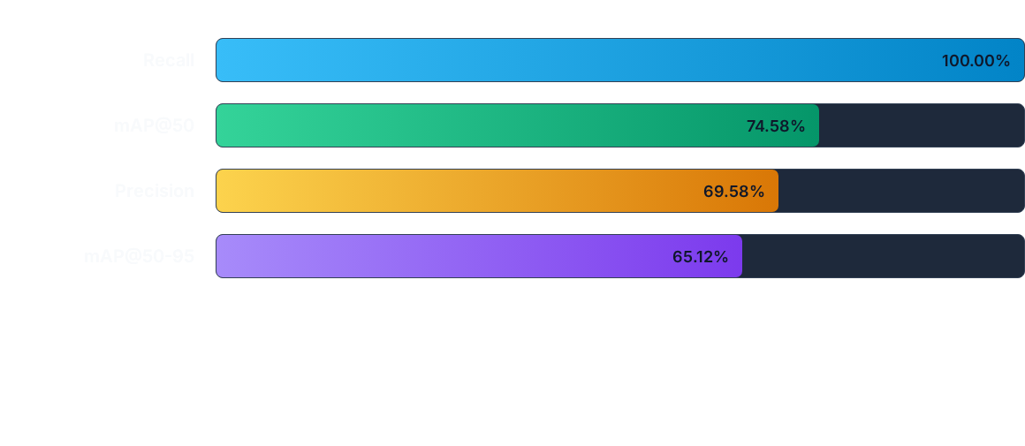
Model Evaluation Results
The perfect 100% recall indicates the model successfully detected all relevant hand regions. While precision reflects minor false positives, mAP@50 demonstrates strong, highly viable detection quality for a custom dataset.

Slide 32
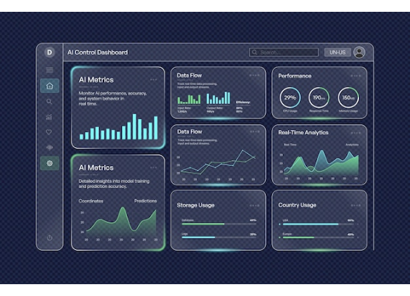
Interface Demo Walkthrough
1. Launch Application: The Streamlit app is initialized securely within the local development environment.
2. Upload Test Image: Users upload UV hand images via a simple drag-and-drop mechanism (JPG/PNG/WEBP).
3. Execute Detection: The image is instantly passed to the memory-resident YOLOv8 model.
4. Display Results: The UI dynamically renders bounding boxes, class labels (Clean/Partial/Dirty), and confidence scores directly over the original image.

Slide 33
08. Project Management
Anticipating risks and maintaining extreme budget efficiency throughout the project lifecycle.

Slide 34
Risk Assessment & Mitigation
Identified Risk | Impact | Mitigation Strategy
Insufficient Dataset Size | High | Collect additional images dynamically and apply heavy algorithmic augmentation.
Poor Annotation Quality | High | Implement strict manual verification protocols for all auto-generated labels.
Hardware Limitations | Medium | Utilize CUDA GPU-enabled training environments to drastically cut render times.
Integration Failures | Medium | Conduct incremental integration testing at the end of every sprint cycle.

Slide 35
Project Cost Efficiency
£70
Maximizing Open-Source Capital
This project was executed with extreme budget efficiency by leveraging enterprise-grade open-source platforms.
Total Expenditure
Software costs for Roboflow, Python, Streamlit, and YOLOv8 were £0. Hardware utilized existing laptops and cameras. The only expenditures were £20 for a specialized UV Lamp, and £50 allocated for utilities and miscellaneous testing supplies.

Slide 36
09. Ethics & Compliance
Ensuring the technology is built and deployed responsibly, fairly, and transparently.

Slide 37

Privacy & Responsible AI
Data Privacy
Zero personally identifiable information (PII) was collected. Images focus strictly on hand regions and are used exclusively for training without permanent backend storage.
Fairness & Transparency
Demographic diversity and data augmentation minimize systemic bias. Bounding boxes ensure the AI's "thought process" is fully visible and explainable to the end-user.
Safe Usage Limits
Designed explicitly as an educational support tool, not a diagnostic medical device.

Slide 38






FAIR Report: AI Tool Usage
ChatGPT (OpenAI)
Roboflow
YOLOv8 (Ultralytics)
Utilized as a supplementary research assistant for understanding object detection methodologies, exploring implementation strategies, and proofreading complex documentation. All outputs were strictly human-verified.
Leveraged heavily for dataset management, image preprocessing, and data augmentation. Auto-labelling features accelerated workflows, though every label was subjected to rigorous manual quality control.
Selected as the foundational object detection framework due to its enterprise-grade accuracy and speed. Final model configuration and evaluation remained the strict responsibility of the student team.

Slide 39

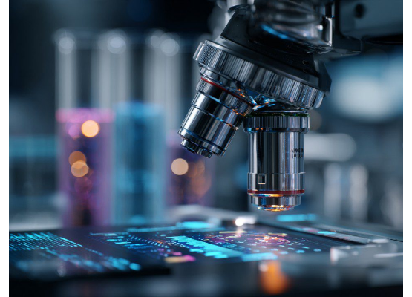
Future Opportunities
The successful proof-of-concept lays a robust foundation for significant future technological expansions:
•
Real-Time Video Analytics: Transitioning from static image uploads to live, continuous webcam assessment.
•
Mobile Deployment: Porting the model to mobile edge-devices for on-the-go clinical usage.
•
Expanded Demographics: Building larger, multi-institutional datasets to ensure absolute global fairness.
•
Severity Estimation: Granular quantification of contamination percentage.

Slide 40
Conclusion & Q&A
Thank you for your time and attention.
The project successfully demonstrates that AI and computer vision can accurately classify hand cleanliness, providing a practical, responsibly-developed solution to a real healthcare challenge.

Slide 41






Image Sources
https://img.magnific.com/premium-photo/team-software-development-engineers-having-meeting-artificial-intelligence-research-cent_1313853-216691.jpg?semt=ais_hybrid&w=740&q=80
Source: www.magnific.com
https://static.vecteezy.com/system/resources/previews/070/588/981/large_2x/doctor-washing-hands-in-modern-hospital-setting-photo.jpg
Source: www.vecteezy.com
https://img.freepik.com/premium-vector/agile-scrum-task-kanban-board-with-sticky-notes-team-work-visual-management_503161-581.jpg
Source: www.magnific.com
https://i.redd.it/45sg8c0l5rke1.jpeg
Source: www.reddit.com
https://png.pngtree.com/png-clipart/20250206/original/pngtree-futuristic-artificial-intelligence-concept-with-a-glowing-human-brain-png-image_20339102.png
Source: pngtree.com
https://img.magnific.com/premium-vector/ai-control-dashboard-interface-real-time-data-analytics-performance-monitoring_439195-253.jpg
Source: www.magnific.com

Slide 42



Image Sources
https://static.vecteezy.com/system/resources/thumbnails/026/384/935/small_2x/futuristic-glowing-padlock-with-plexus-lines-and-glitter-particles-a-padlock-in-the-neon-light-style-cyber-security-data-and-privacy-protection-digital-technology-background-vector.jpg
Source: www.vecteezy.com
https://images.presentationgo.com/2025/07/futuristic-microscope-lab.jpg
Source: www.presentationgo.com
https://img.magnific.com/premium-photo/abstract-digital-network-with-glowing-connections-flowing-lines-medical-technology-concept_138943-4523.jpg?semt=ais_hybrid&w=740&q=80
Source: www.magnific.com

